Slide 1


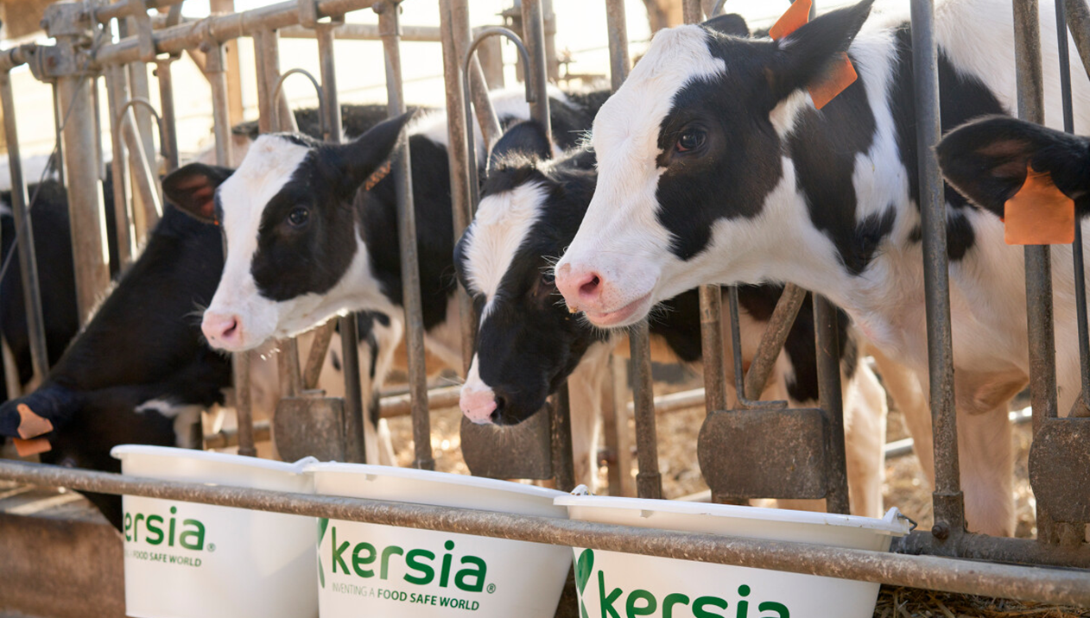
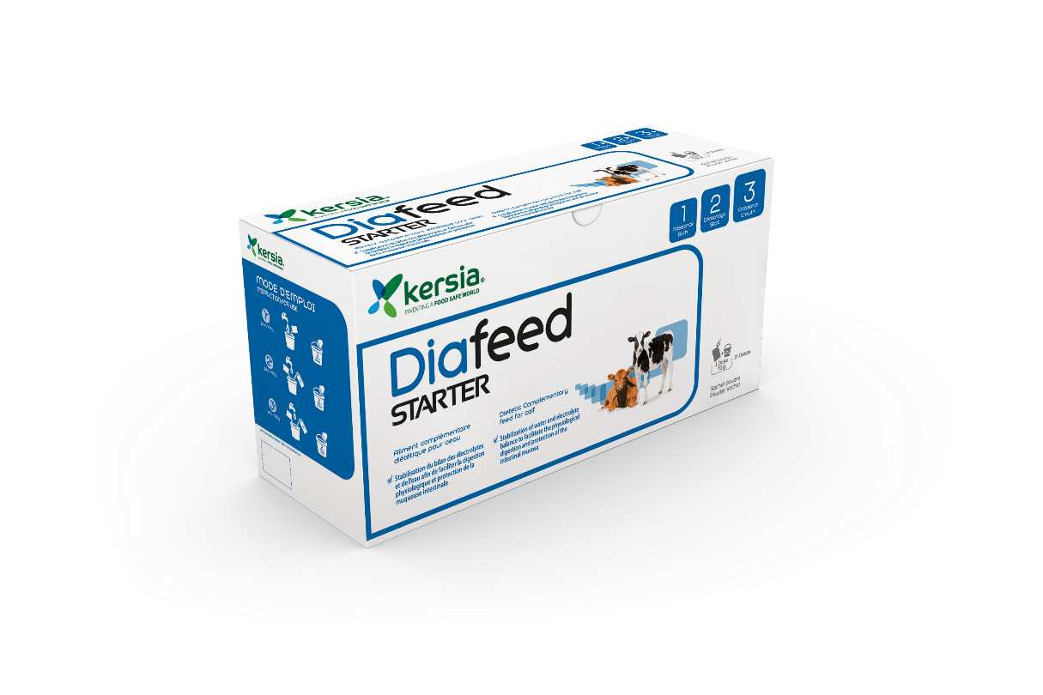

Diafeed
Dietetic Complementary Feed
Rehydrating powder to use when risk of digestive disorders with additional protection of the intestinal mucosa

Slide 2






Diafeed
Rehydrating powder to use when risk of digestive disorders with additional protection of the intestinal mucosa
ADVANTAGES
Complete formula covering the various consequences of digestive disorders:
rehydration
intestinal protection
stimulation of intestinal flora
buffering effect on ruminal pH
energy supplementation
Easy administration:
Powder galenic for fast and simple application
Good palatability thanks to the apple flavour
Rehydration Pack:
Electrolytes
Pectins
Betaine
Rice flour​
Control pH substances:
sodium bicarbonate for buffer effect
Particular nutritional purpose:
Stabilization of water and electrolyte balance to support the physiological digestion
Protection of the intestinal mucosa
Intestinal Pack:
Yeasts
Spirulina
Pectins
Oligofructose
​
Energy Pack:
Dextrose
Vitamin C
Pectins
WHEN & HOW
At times of risk of digestive disorders, during and after these.
DAY 1
Dissolve one dose of 70g of Diafeed in 2L of lukewarm water and distribute 3 times with an interval of 6 hours.
DAY 2
If the calf shows sign of improvement, dilute one dose of Diafeed in 1L of lukewarm water and 1L of milk. Distribute 2 times per day. If there is no improvement, repeat the procedure from DAY 1
One dose of 70g
DAY 3
Same procedure as DAY 2. If no improvement is noted after 3 days, consult a veterinary surgeon.
PACKAGING
Case 1,47kg= 21 sachets ≈ 3 calves
Bucket 3,5kg (50 doses) ≈7 calves
09/2023

